Slide 1
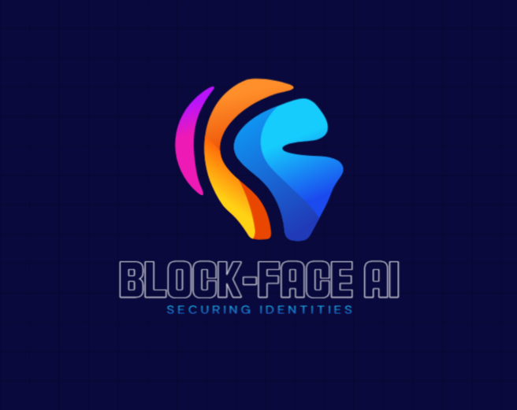

Slide 2

Block-face ai
Technoteam
Mudrika patel
Priyanshu Kumar Gupta
Sweety chouhan
Himanshu Kumar
T

Slide 3
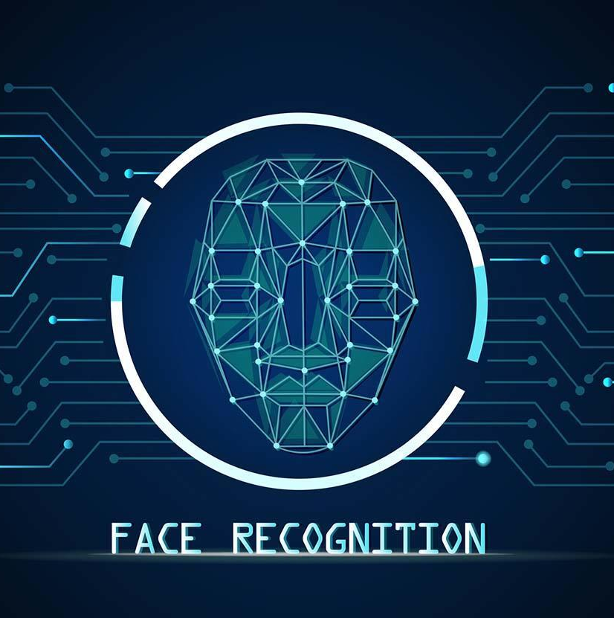
Introduction
Introducing the project by explaining the importance of fraud detection in today's digital age.
The topic revolves around creating a clone-recognizing website aimed at detecting fake identities and combating fraud using advanced AI and facial recognition techniques.
Fraudulent activities, such as identity theft, deepfakes, and spoofing,

Slide 4

BAsic AI Methods for Image Swapping/Manipulation
Generative Adversarial Networks (GANs):
GANs are widely used for generating realistic images and videos. Models like StyleGAN and DeepFake utilize GANs for face swapping and manipulation.
Autoencoders:
Autoencoders compress and reconstruct images, making them useful for tasks like face swapping by encoding features from one image and applying them to another.
Image-to-Image Translation:
Techniques like Pix2Pix and CycleGAN are used for transforming images from one domain to another (e.g., turning sketches into realistic images).
Face Alignment and Feature Extraction:
Libraries like Dlib and OpenCV are used for detecting and aligning facial features, which are essential for accurate manipulation.
Deep Learning Models:
Convolutional Neural Networks (CNNs) are employed for tasks like face detection, segmentation, and feature extraction.
One-Shot Learning:
Approaches like GHOST (Generative High-fidelity One Shot Transfer) enable face swapping with minimal data, making them efficient for image/video manipulation.

Slide 5
Objectives
- Build a secure platform for detecting fake identities.
- Leverage AI models for accurate facial recognition, liveness verification, and deepfake detection.
- Provide users with real-time fraud detection results while prioritizing privacy and security.

Slide 6
Problem Statement
Discuss the challenges faced by current systems, such as:
- Ineffectiveness of traditional methods (e.g., passwords) against identity fraud.
- Difficulty in detecting manipulated media like deepfakes.
- User concerns about privacy and data security.
Position your system as a solution to these issues.

Slide 7
System Architecture
Present a high-level diagram of the system, showing:
- Frontend: User interactions like uploads and verification results.
- Backend: AI-powered processing and secure data handling.
- AI Models: Integration of FaceNet, DeepFace, or custom models for detection.

Slide 8
Key Features
- Facial Verification: Real-time detection of identity clones.
- Liveness Detection: Prevent spoofing with gestures or movements.
- Deepfake Detection: Identify manipulated media using AI techniques.
- Secure User Management: Profiles, history, and customizable preferences.

Slide 9
Technologies Used
Frontend: HTML , CSS , JS for dynamic interfaces.
Backend: JS , Flask for API development
AI Models: Convolutional Neural Networks (CNNs) and anomaly detection

Slide 10
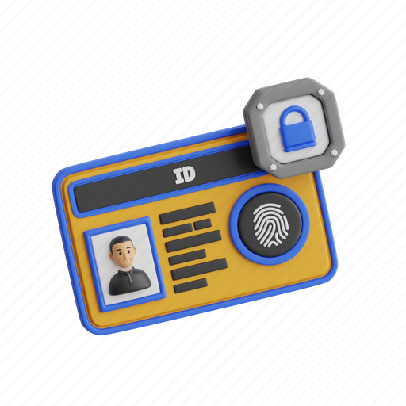
PRIVACY & Ethical Considerations
- Encrypted data storage and transmission.
- Store only essential data and delete sensitive information once verification is complete.
- Transparency in detecting and reporting fraud, while avoiding misuse.

Slide 11

Applications
Banking: Secure login and ATM transactions.
E-commerce: Prevent fake accounts and secure purchases.
Restricted Access: Use in government facilities or private businesses.
Educational Platforms.
Travel and Immigration

Slide 12

Challenges and Future Scope
Discuss challenges like detecting sophisticated deepfakes or improving model accuracy.
Explore future enhancements like:
Real-time fraud analytics.
Integration with IoT devices (e.g., smart security systems).

Slide 13
Conclusion
Wrap up with a summary of the platform’s benefits:
- Combating fraud effectively using AI technologies.
- Enhancing user trust and safety in digital transactions.
- Contributing to the broader fight against identity fraud and misuse.

